Slide 1
Programming Logic and Design Seventh Edition
Chapter 1
An Overview of Computers and
Programming

Slide 2
Objectives
In this chapter, you will learn about:
Computer systems
Simple program logic
The steps involved in the program development cycle
Pseudocode statements and flowchart symbols
Using a sentinel value to end a program
Programming and user environments
The evolution of programming models

Slide 3
Understanding Computer Systems
Computer system
Combination of all the components required to process and store data using a computer
Hardware
Equipment associated with a computer
Software
Computer instructions
Tells the hardware what to do
Programs
Instructions written by programmers

Slide 4
Understanding Computer Systems (continued)
Application software such as word processing, spreadsheets, payroll and inventory, even games
System software such as operating systems like Windows, Linux, or UNIX
Computer hardware and software accomplish three major operations
Input
Data items such as text, numbers, images, and sound
Processing
Calculations and comparisons performed by the central processing unit (CPU)

Slide 5
Understanding Computer Systems (continued)
Output
Resulting information that is sent to a printer, a monitor, or storage devices after processing
Programming language
Used to write computer instructions
Examples
Visual Basic, C#, C++, or Java
Syntax
Rules governing word usage and punctuation

Slide 6
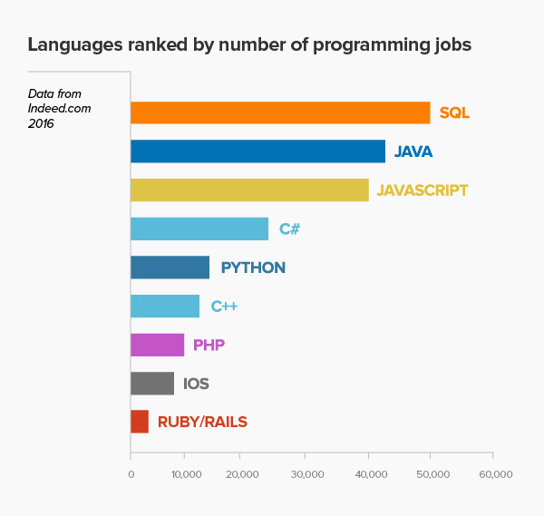
The 9 Most In-Demand Programming Languages of 2016
http://www.codingdojo.com/blog/9-most-in-demand-programming-languages-of-2016/

Slide 7
Understanding Computer Systems (continued)
Computer memory
Computer’s temporary, internal storage – random access memory (RAM)
Volatile memory – lost when the power is off
Permanent storage devices
Nonvolatile memory
Compiler or interpreter
Translates source code into machine language (binary language) statements called object code
Checks for syntax errors

Slide 8
Understanding Simple Program Logic
Program executes or runs
Input will be accepted, some processing will occur, and results will be output
Programs with syntax errors cannot execute
Logical errors
Errors in program logic produce incorrect output
Logic of the computer program
Sequence of specific instructions in specific order
Variable
Named memory location whose value can vary. Also called an identifier. At any moment a variable holds just one value.

Slide 9
Understanding the Program Development Cycle
Program development cycle
Understand the problem
Plan the logic
Code the program
Use software (a compiler or interpreter) to translate the program into machine language
Test the program
Put the program into production
Maintain the program

Slide 10
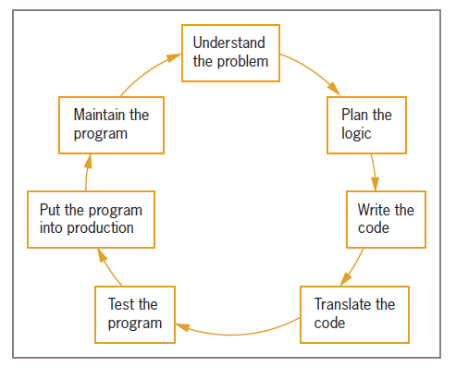
Understanding the Program Development Cycle
Figure 1-1 The program development cycle

Slide 11
1-Understanding the Problem
One of the most difficult aspects of programming
Users or end users
People for whom a program is written
Documentation
Supporting paperwork for a program

Slide 12
2-Planning the Logic
Heart of the programming process
Most common planning tools
Flowcharts
Pseudocode
IPO charts (input, processing, and output)
TOE charts (tasks, objects, and events)
Desk-checking
Walking through a program’s logic on paper before you actually write the program

Slide 13
3-Coding the Program
Hundreds of programming languages available
Choose based on features
Similar in their basic capabilities
Easier than the planning step

Slide 14
4-Using Software to Translate the Program into Machine Language
Translator program
Compiler or interpreter
Changes the programmer’s English-like high-level programming language into the low-level machine language
Syntax error
Misuse of a language’s grammar rules
Programmer corrects listed syntax errors
Might need to recompile the code several times

Slide 15
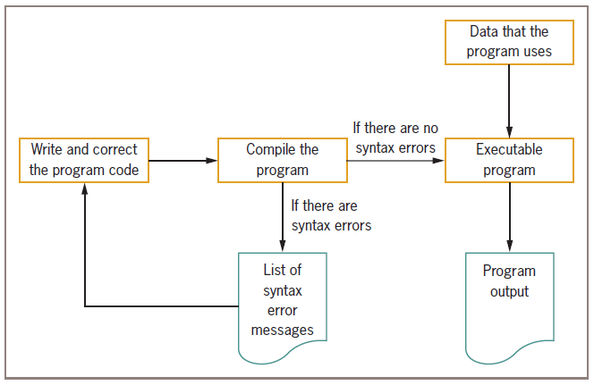
Using Software to Translate the Program into Machine Language (continued)
Figure 1-2 Creating an executable program

Slide 16
5-Testing the Program
Program is free of syntax error doesn’t mean to be free of logical (semantic) errors.
Execute the program with sample data and check results whether it is logically correct.
Logical error
Results when a syntactically correct statement, but the wrong one for the current context, is used
Test
Execute the program with some sample data to see whether the results are logically correct
Debugging is the process of finding and correcting program errors
Programs should be tested with many sets of data

Slide 17
6-Putting the Program into Production
Process depends on program’s purpose
May take several months
Conversion
Set of actions an organization must take to switch over to using a new program or set of programs

Slide 18
7-Maintaining the Program
Maintenance
Making changes after the program is put into production
Common first programming job
Maintaining previously written programs
Make changes to existing programs
Repeat the development cycle

Slide 19
Using Pseudocode Statements and Flowchart Symbols
Pseudocode
English-like representation of the logical steps it takes to solve a problem
Flowchart
Pictorial representation of the logical steps it takes to solve a problem

Slide 20
Writing Pseudocode
Pseudocode representation of a number-doubling problem:
start
input myNumber
set myAnswer = myNumber * 2
output myAnswer
Stop
Or Pseudocode representation of a Adding Two Integers:
start
input myNumber1, myNumber2
set myAnswer = myNumber1 + myNumber2
output myAnswer
Stop

Slide 21
Program to Add Two Integers in C Language
#include <stdio.h>
int main()
{
int myNumber1, myNumber2, myAnswer;
printf("Enter two integers: ");
// Two integers entered by user is stored using scanf() function
scanf("%d %d", &myNumber1, &myNumber2);
// sum of two numbers in stored in variable myAnswer
myAnswer = myNumber1 + myNumber2;
// Displays sum
printf("%d + %d = %d", myNumber1, myNumber2, myAnswer);
return θ;
}
Programming Logic and Design, Seventh Edition

Slide 22
Explanation of the Adding C Program
In this program, user is asked to enter two integers. Two integers entered by the user is stored in variables myNumber1 and myNumber2 respectively. This is done using scanf() function.
Then, variables myNumber1 and myNumber2 are added using + operator and the result is stored in myAnswer.

Slide 23
Writing Pseudocode (continued)
Programmers preface their pseudocode with a beginning statement like start and end it with a terminating statement like stop
Flexible planning tool

Slide 24


Drawing Flowcharts
Create a flowchart
Draw geometric shapes that contain the individual statements
Connect shapes with arrows
Input symbol
Indicates input operation
Parallelogram
Processing symbol
Contains processing statements such as arithmetic
Rectangle

Slide 25



Drawing Flowcharts (continued)
Output symbol
Represents output statements
Parallelogram
Flowlines
Arrows that connect steps
Terminal symbols
Start/stop symbols
Shaped like a racetrack
Also called lozenges

Slide 26
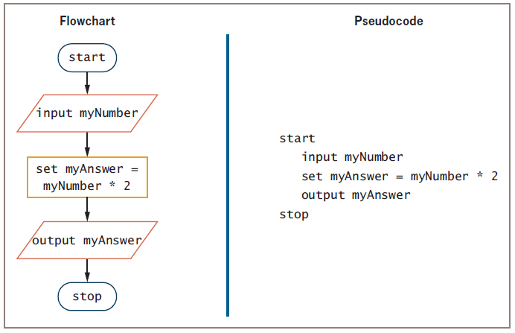
Drawing Flowcharts (continued)
Figure 1-6 Flowchart and pseudocode of program that doubles a number

Slide 27
Repeating Instructions
Program in Figure 1-6 only works for one number
Not feasible to run the program over and over 10,000 times
Not feasible to add 10,000 lines of code to a program
Create a loop (repetition of a series of steps) instead
Avoid an infinite loop (repeating flow of logic that never ends)

Slide 28
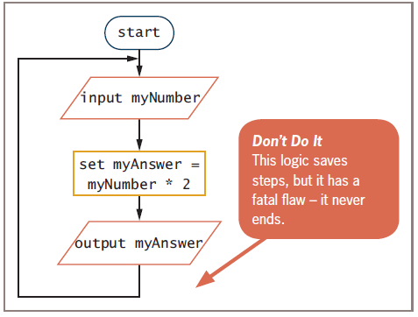
Repeating Instructions (continued)
Figure 1-8 Flowchart of infinite number-doubling program

Slide 29
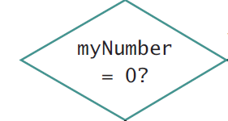
Using a Sentinel Value to End a Program
Making a decision
Testing a value
Decision symbol
Diamond shape
Dummy value
Data-entry value that the user will never need
Sentinel value
eof (“end of file”)
Marker at the end of a file that automatically acts as a sentinel

Slide 30
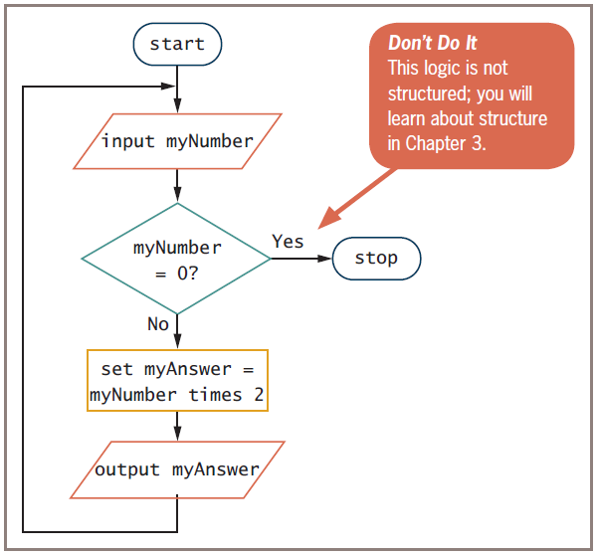
Using a Sentinel Value to End a Program (continued)
Figure 1-9 Flowchart of number-doubling program with sentinel value of 0

Slide 31
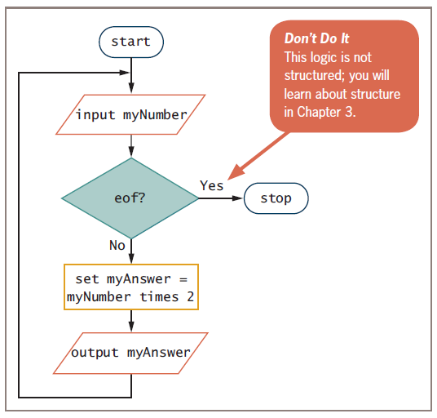
Using a Sentinel Value to End a Program (continued)
Figure 1-10 Flowchart using eof

Slide 32
Understanding Programming and User Environmentsبيئة المستخدم
Many options for programming and user environments
Planning
Flowchart
Pseudocode
Coding
Text editors
Executing
Input from keyboard, mouse, microphone
Outputting
Text, images, sound

Slide 33
Understanding Programming Environments فهم بيئة البرنامج
Use a keyboard to type program statements into an editor
Plain text editorمحرر النصوص
Similar to a word processor but without as many features
Text editor that is part of an integrated development environment (IDE)بيئة التطوير المتكامل
Software package that provides an editor, a compiler, and other programming tools

Slide 34
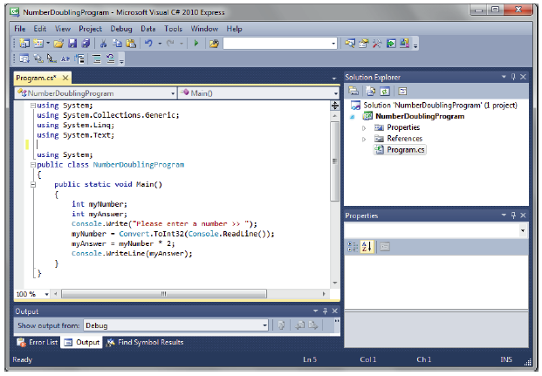
Understanding Programming Environments (continued)
Figure 1-12 A C# number-doubling program in Visual Studio

Slide 35
Understanding User Environments
Command line
Location on your computer screen where you type text entries to communicate with the computer’s operating system
Graphical user interface (GUI)
Allows users to interact with a program in a graphical environment

Slide 36
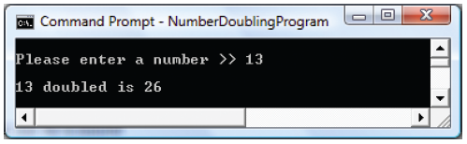
Understanding User Environments (continued)
Figure 1-13 Executing a number-doubling program
in a command-line environment

Slide 37
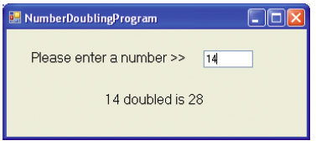
Understanding User Environments (continued)
Figure 1-14 Executing a number-doubling program
in a GUI environment

Slide 38
Understanding the Evolution of Programming Models
People have been writing modern computer programs since the 1940s
Newer programming languages
Look much more like natural language
Are easier to use
Create self-contained modules or program segments that can be pieced together in a variety of ways

Slide 39
Understanding the Evolution of Programming Models (continued)
Major models or paradigms used by programmers
Procedural programming
Focuses on the procedures that programmers create
Object-oriented programming
Focuses on objects, or “things,” and describes their features (or attributes) and their behaviors
This text
Focuses on procedural programming techniques

Slide 40
Summary
Hardware and software accomplish input, processing, and output
Logic must be developed correctly
Logical errors are much more difficult to locate than syntax errors
Use flowcharts, pseudocode, IPO charts, and TOE charts to plan the logic
Avoid infinite loops by testing for a sentinel value
Use a text editor or an IDE to enter your program statements

